Slide 1

EduEasy
Smart Learning Assistant System

Slide 2
Infographic Style
Meet Our Team
Supervisor
Dr. Anuradha Karunasena
Jayasuriya J.A.T.P.
P.D. Gallage
IT17112192
IT17407458
J.M.S.D. Jayasundara
L.A.P.Y.P. Nuwanjaya
IT17153096
IT17106634

Slide 3
Agenda
What is EduEasy?
Why EduEasy?
Our Objectives
System Architecture
Existing Literature & Methodology
Comparison of Existing Products
Tools & Technologies
Work Breakdown Structure
User Requirements
Business Potential

Slide 4
What is EduEasy?
Smart learning assistant system.
Web application.
Designed for university lecture room environment.
Helps students to easily understand lecture slide components by matching the lecture slides.
Make summarized notes quickly.
Find references and related questions online.

Slide 5
Why EduEasy?
Struggle in the last moment.
Can not find lecture notes.
Not enough time to refer big notes.
Provides summarized notes.
Can practice for exams with questions.
Easier to find references so students can study further.

Slide 6
Our Objectives
Main Objective : Develop an E-learning application for students to effectively learn and revise lectures done at the university.
Note Taker
Reference Finder
Question Presenter
Slide Matcher
Get the voice record of the lecturer and transcribe it into a summarized note.
Find exact important reference materials relevant to given topic.
Find questions online relevant to different parts of the lecture.
Matching the lecture slide content according to the topics in generated summarized note.

Slide 7
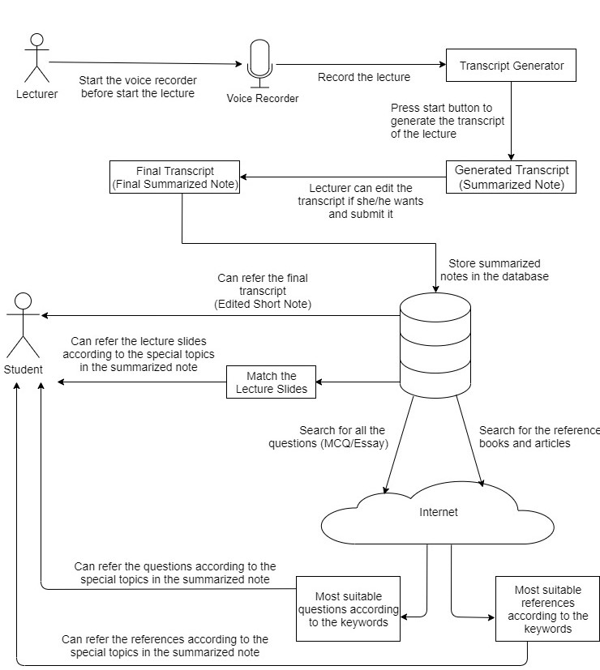
System Architecture

Slide 8
Existing Products &
Methodology

Slide 9

Note Taker Component
01
01
Online word processing tool.
Lot of functions.
Multilingual.
Can summarize texts.
No audio to text summarizations

Slide 10
Research done on Note Taker Component
[1] T. Kawahara, H.Nanjo & S. Furui, “Automatic transcription of spontaneous lecture speech” in IEEE Workshop on Automatic Speech Recognition and Understanding, 2001.
01
Spontaneous Transcription
[2] C. Munteanu, G. Penn, R. Baecker, “Web-Based Language Modelling for Automatic Lecture Transcription” in 8th Annual Conference of the International Speech Communication Association, 2007.
02
Language Modelling
[3] A. Park, T.J. Hazen, J.R. Glass, “Automatic processing of audio lectures for information retrieval: vocabulary selection and language modeling” in Proceedings. (ICASSP '05). IEEE International Conference on Acoustics, Speech, and Signal Processing, 2005.
03
Audio Processing

Slide 11


Note Taker Flow Diagram
Create a summarized note
Voice is recorded to the computer
Transcribe audio into text format
Student can refer the summarized note
Cloud Database
Edit and Submit

Slide 12


Reference Finder Component
02
01
02
Learning resource finder.
Web application.
Search matching references for given key words.
Only have slide presentations.
Learning resource finder.
Web application.
Search matching references for given key words.
Only have articles.
Only search in limited databases at California State University and some other university.

Slide 13
Research done on Reference Finder Component
[1] S. Beyer and M. Pinzger, “Synonym Suggestion for Tags on Stack Overflow” in IEEE International Conference on Program Comprehension, 2015, vol. 2015–August, pp. 94–103.
01
Identify Synonyms
[2] X. Song, J. Feng, G. Li and Q. Hong, “LCA-based Keyword Search for Effectively Retrieving “Information Unit” from Web Pages”, in The Ninth International Conference on Web-Age Information Management, 20-22 July 2008.
02
Retrieving Results
[3]A.D Patel and V.N. Pandya, “Web Page Classification based on Context to the Content Extraction of Articles”, in 2017 2nd International Conference for Convergence in Technology (I2CT), 7-9 April 2017.
03
Select most suitable result

Slide 14


Reference Finder Flow Diagram
Choose a summarized note form the database
Select key phrases (topic) for search
Cloud Database
Check synonyms for given keywords
Select most suitable results
Student can refer the relevant references
Retrieving all the results
Automatic google search for references

Slide 15

Question Presenter Component
03
01
Present questions according to topics.
Web application.
Search matching questions for given key words.
Only have questions regarding limited subjects and topics.

Slide 16
Research done on Question Presenter Component
[1] K. Hammond,R. Burke,C. Martin,S. Lytinen,"FAQ finder: a case-based approach to knowledge navigation“ in Proceeding the 11th Conference of Artificial Intelligence for Applications,1995.
01
FAQ Finder
[2] Naveed Afzal,Ruslan Mitkov,"Automatic generation of multiple choice questions using dependency-based semantic relations“ ,2014.
02
Automatic MCQ

Slide 17

Question Presenter Flow Diagram
Choose a summarized note form the database
Select key phrases (topic) for search
Cloud Database
Check synonyms for given keywords
Select most suitable results
Student can refer the relevant questions
Automatic google search for questions

Slide 18


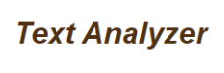
Slide Matcher Component
04
01
02
03
Compare content by submitting urls.
Show the similarity of sentence
Compare images with textual content (jpg, jpeg, png, bmp)
Should upload files manually.
Free software
Allows to find the most frequent phrases.
Non-English texts are also supported
Counts number of words, sentences.
Show the count of unique word of a paragraph

Slide 19
Research done on Slide Matcher Component
[01] Pantulkar Shravanthi, Dr. B. Srinivasu “Semantic similarity between sentences” M.tech Scholar Dept. of Computer Science and Engineering, Stanley College of Engineering and Technology for Women, Telangana- Hyderabad, India, International Research Journal of Engineering and Technology
Natural Language Processing
01
[02] LajanugenLogeswaran, HonglakLee, DragomirRadev “Sentence Orderingand Coherence Modeling Using Recurrent Neural Networks” Department of Computer Science & Engineering, University of Michigan 2Department of Computer Science, Yale University, The Thirty-Second AAAI Conference on Artificial Intelligence (AAAI-18)
02
Compare similarities of two sentences
[3] ] Adrien Sieg “Text Similarities : Estimate the degree of similarity between two texts” (https://medium.com/@adriensieg/text-similarities-da019229c894)
03
Algorithm for NLP

Slide 20
Slide Matcher Flow Diagram
Choose a summarized note from database
Find the appropriate lecture presentation
according to the main tittle
Cloud Database
Navigate to the exact lecture slide
Find the relevant sub topic from lecture presentation
Students can refer relevant lecture slide easily.

Slide 21
Comparison of Existing Products
 | LiguaKit | SlidePlayer | CSUN | GoConar | CopyLeaks | Proposed Solution
Search in any place on the internet | ✗ | ✗ | ✗ | ✗ | ✗ | ✔
Show user targeted recommendations | ✗ | ✔ | ✔ | ✔ | ✗ | ✔
Search every type of reference materials | ✗ | ✗ | ✗ | ✗ | ✗ | ✔
Search every type of questions(MCQ/Essay) | ✗ | ✗ | ✗ | ✗ | ✗ | ✔
Can summarize audio transcripts | ✗ | ✗ | ✗ | ✗ | ✗ | ✔
Can format the note under sub topics | ✗ | ✗ | ✗ | ✗ | ✗ | ✔
Can generate synonyms for selected key phrases | ✗ | ✗ | ✗ | ✗ | ✔ | ✔
Free of charge | ✔ | ✔ | ✔ | ✔ | ✔ | ✔
Provide Web platform | ✔ | ✔ | ✔ | ✔ | ✔ | ✔

Slide 22
Tools & Technologies
Hardware
Google Cloud Server
Voice Recorder on laptop
Machine learning algorithms
Note Taker
Voice Recorder on laptop
Python
Summarization algorithm
Reference Finder
Python
Question Presenter
Python
Slide Matcher
Python
Common Software
Java
Spring Boot Framework
Eclipse IDE
Apache Tomcat Application Server
MySQL DB

Slide 23
Develop an algorithm to identify important keywords from the notes.
Create a method to search for online references using those keywords.
Develop a method to select most suitable results.
Work Breakdown
Structure
Develop an algorithm to identify important keywords from the notes.
Create a method to search for online relatable questions using those keywords.
Develop a method to categorize the questions according to the type (MCQ/Essay).
Reference Finder
P.D. Gallage
Question Presenter
J.M.S.D. Jayasundara
Note Taker
J.A.T.P. Jayasuriya
Slide Matcher
L.A.P.Y.P. Nuwanjaya
Develop a method to create a transcript of the voice recording.
Create an algorithm to identify the important parts of the voice record.
Create a summarized lecture note by removing unnecessary parts.
Create an algorithm to identify unique keywords/phrases which are common to both lecture slides & the summarized note.
create a method to match lecture slides with the particular area of the note.
Develop the web application.

Slide 24
User Requirements
Functional Requirements
Non-Functional Requirements
Voice record of the lecturer should be transcribed into a summarized note.
Find exact important reference materials relevant to given topic.
Find questions online relevant to different parts of the lecture.
Should match the lecture slide content according to the topics in generated summarized note.
Quick responsive.
User friendly.
Easy to navigate.
Affordable price.

Slide 25


Business Value
Fully Functional web application.
Free version & Paid version.
University students and lectures.
What are we selling
Our Market Space
Our Market Segment
Directly Dealing with Sri Lankan Ministry of Education to promote the product among government & private universities.

Slide 26
Thank You

